Slide 1
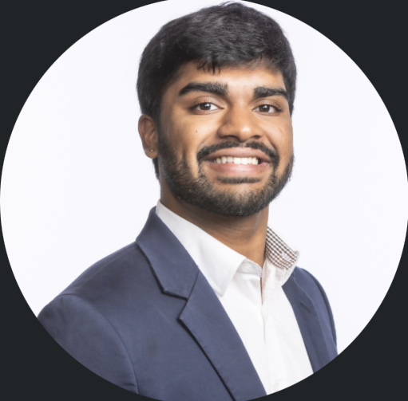
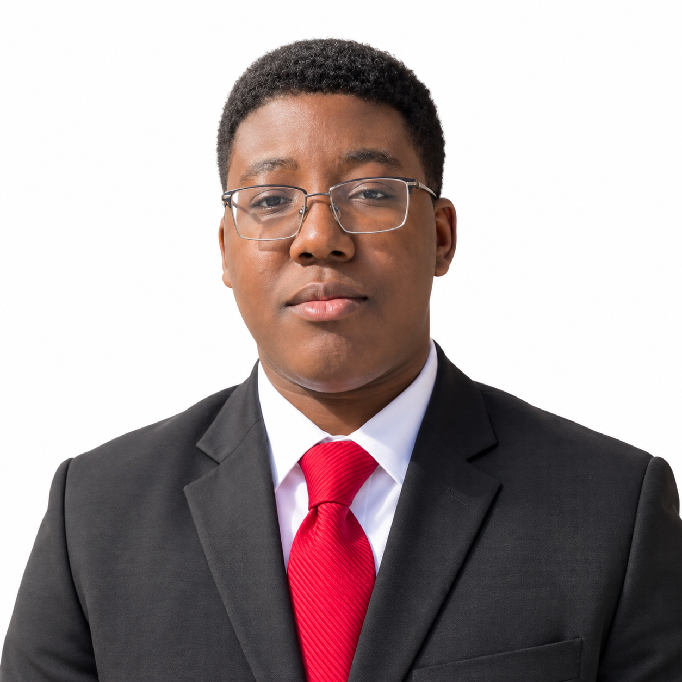
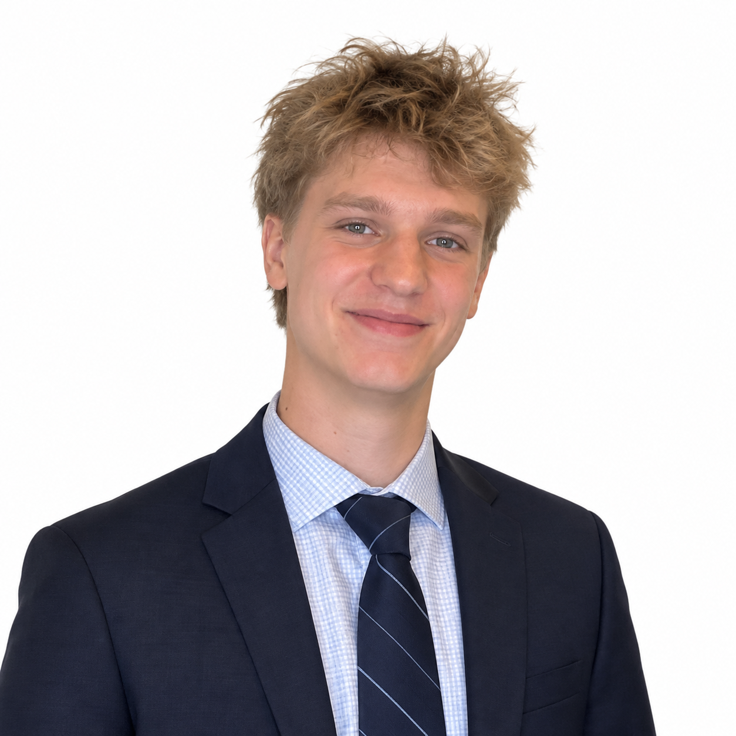
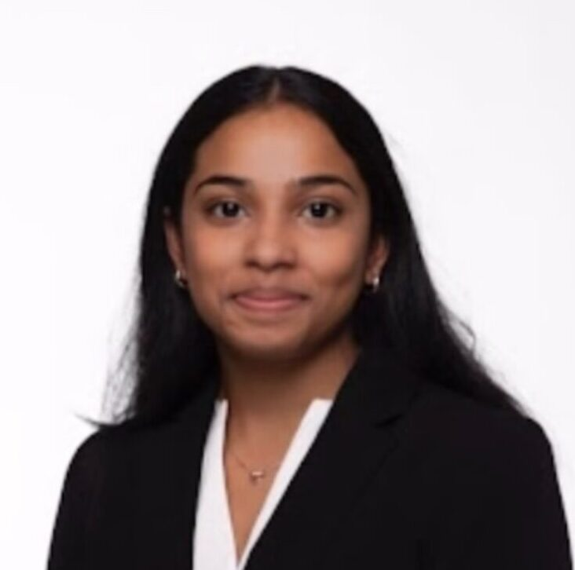
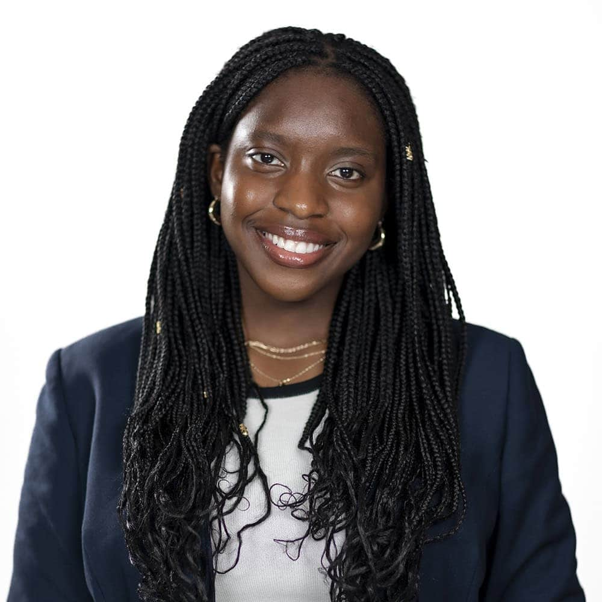









Suhan Asaigoli ‘27
Neuroscience
Morehead Cain Scholar
Favor Asabor ‘27
Health Policy and Management
Honors Carolina
Aidan Gunn ‘27
Communication studies
Johnston Scholar
Niharika Koppolu ‘29
Biostatistics
Morehead Cain Scholar
Amy Okonkwo ‘28
Environmental Health Sciences
Morehead Cain Scholar

